Slide 1
City News Beat
Nick Kellam, Kevin Jackson, Vijay Rachakonda, Keilly Leyva

Slide 2
Functional Overview

Slide 3
Functional Overview
Free app that provides local news to Roku and Amazon Fire TV users
Targets users without cable television
Currently reporting from San Francisco, Seattle, NYC, and Chapel Hill
Each video is approximately 1-2 minutes long
Cover local events, sports, food, weather, and more
Our role in this process is to find a way to deliver personalized video content to the user

Slide 4
User Interface

Slide 6
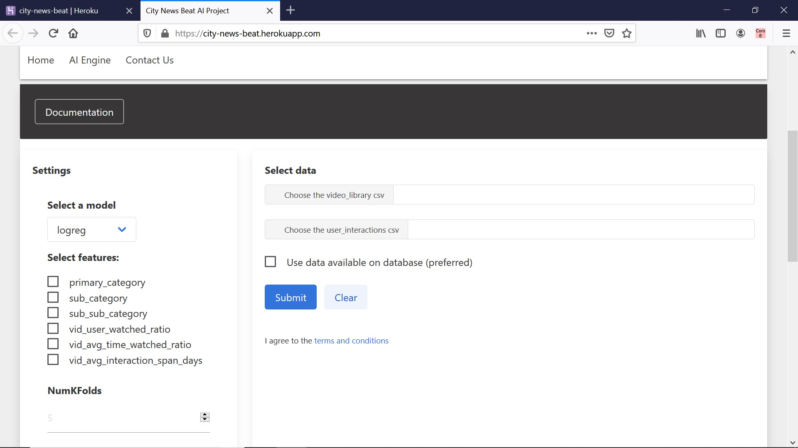

Slide 7
Technical Overview

Slide 8
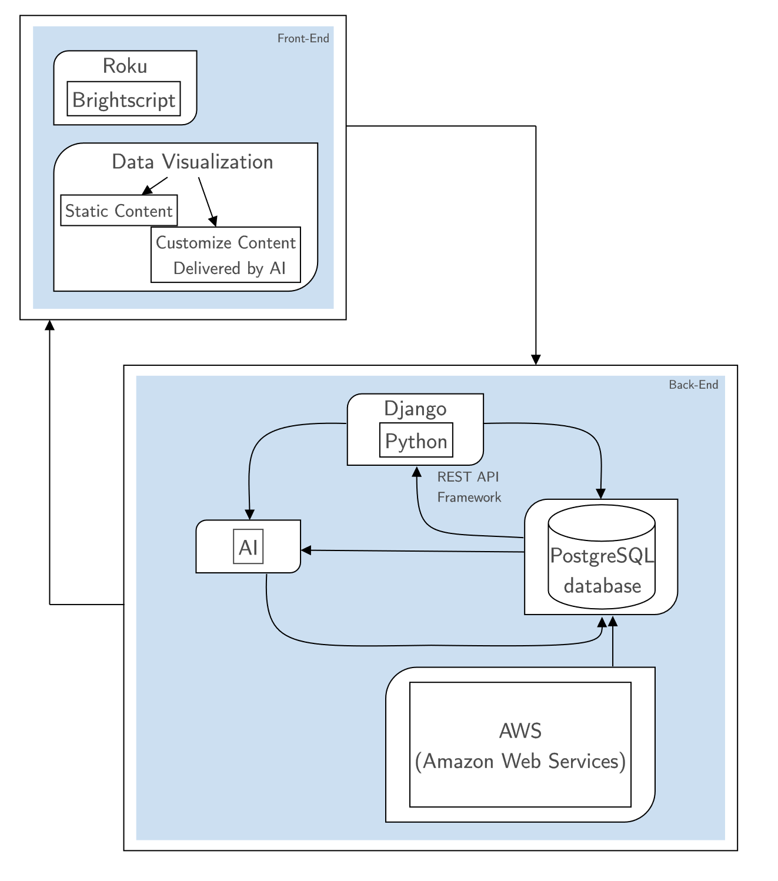
Technical
Overview
Architecture Diagram
Pre -Pivot Diagram

Slide 9
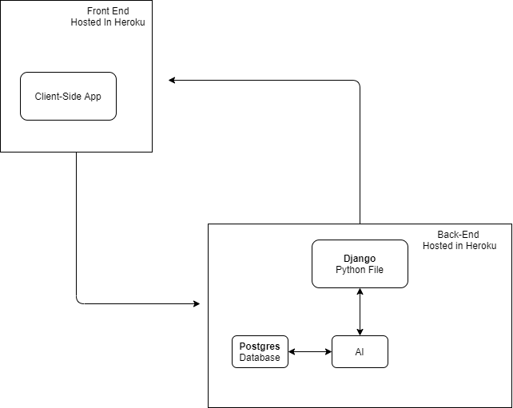
Technical
Overview
Architecture Diagram
Post-Pivot Diagram

Slide 10
Platform Description

Slide 11
Platform Description
Front End - Deployed as a client-side application to Heroku (city-news-beat)
JavaScript - Npm project
Bulma for CSS
Browser-sync for local testing, that is when we are not using it in Heroku
Back End - Deployed as a separate application to Heroku (citybeatapp)
Django - Stores our python script which takes in parameters such as userid, model type, and features from the client-side application and produces an output as a list of probabilities associated with each video that a user has not watched yet.
Postgres Database - When the user decides to use data from the database as opposed to uploading csv files this decision is passed to the python script in Django and the script pulls its data from our Postgres database which is hosted in the citybeatapp Heroku application.

Slide 12
Demo

Slide 13
Lessons Learned
Soft-Skill Lessons:
Importance of Communication
Professionalism
How to explain technical items to non-technical people
Hard-Skill Lessons:
Data is key
Different machine learning models (logreg, knn, etc.)
Connecting Front-End to Back-End
Importance of Documentation

